Slide 1
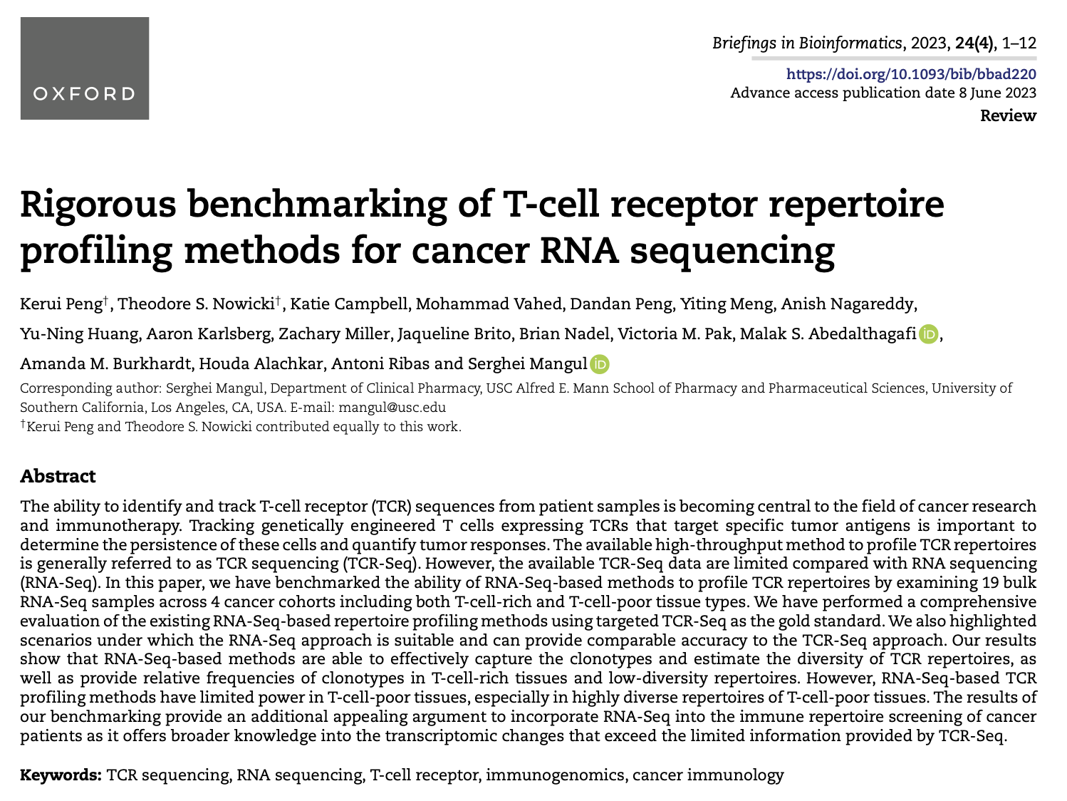
Journal club
1-16-2024
Ty Bottorff

Slide 2
Background
Available TCR-seq data is limited compared with RNA-seq data
MiXCR (RNA-seq method) has detected TCR beta sequences with relative frequencies > 0.15% in T cell rich tissue (PMC6169298)

Slide 3
Goal
Benchmark RNA-Seq-based TCR profiling methods, validate in greater number of samples than previously done
Use RNA-seq-based methods (in lieu of targeted TCR-seq-based ones) to profile TCR repertoires
immune repertoire screenings of cancer patients
measuring diversity, clonality, tracking CAR T cells targeting tumor antigens…
Notes:
CAR Ts: engineered T cells expressing chimeric TCRs

Slide 4
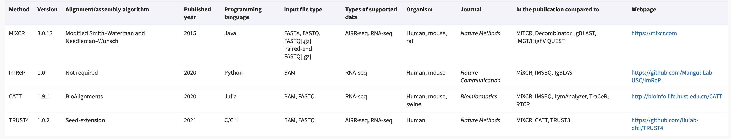
Comparing 4 RNAseq methods to TCRseq
Targeted TCR-seq (gold standard, beta chain)
Assembly algorithm differs by method
Notes:
Assembly may produce erroneous results with bulk RNAseq data due to similar TCRs from different cells (perhaps related to why these RNAseq methods struggle to detect rare TCRs)
Assembly algorithms: Smith-Waterman and Needleman-Wunsch are exact alignment algorithms (slow but always right), seed-extension is a heuristic algorithm (faster but may be incorrect i.e. if target isn’t in candidate seed set) that works by identifying seeds (short regions of high similarity between read and genome) then uses exact alignment algorithm at seeded locations to evaluate candidates and choose optimum

Slide 5
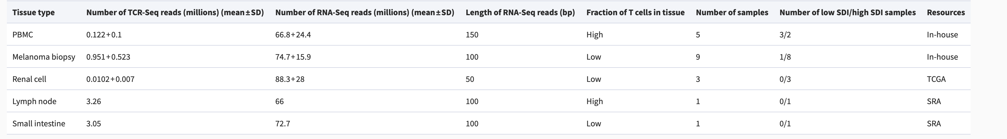
Examining 19 bulk RNAseq samples across 4 cancer cohorts
Lymph node and small intestine samples sequenced by 5’ RACE, processed through MiXCR
Other samples sequenced and processed by ImmunoSEQ (Adaptive)
Notes:
The distribution of the samples is heavily biased toward T-cell-poor high SDI samples compared with other categories. The comparison between sample types with different numbers of samples may lead to over- or underestimating the differences in the results
only two types of cancer were included in this study, which were melanoma and kidney renal clear cell carcinoma. The conclusions from different types of cancers are inherently biological-context dependent. Further validation is needed if more TCR-Seq and RNA-Seq data on the same samples become available
Sequence Read Archive (SRA)
5’ RACE: rapid amplification of 5’ cDNA ends (RACE), ImmunoSeq: multiplex PCR-based assay (biases b/w approaches)
TCRβ alleles were sequenced at 100, 000 reads by Adaptive Biotechnologies.This process utilizes a synthetic immune repertoire, corresponding to every possible biological combination of Variable (V) and Joining (J) gene segments for each TCR locus, spiked into every sample at a known concentration. These inline controls enable rigorous quality assurance for every sample assayed and allow for correction of multiplex PCR amplification bias, providing an absolute quantitative measure of T cells containing the transgenic TCR relative to the other endogenous TCR clonotypes, with no difference in amplification efficiency. Productive TCRβ sequences i.e. those that could be translated into open reading frames and did not contain a stop codon, were reported
Computationally estimated the T-cell levels across all samples by GEDIT
150 bp paired-end sequencing (PBMCs) or 100 bp paired-end sequencing (melanoma biopsies) on a HiSeq 3000 platform.
TCGA renal cell RNA-Seq data are from Illumina HiSeq sequencing of 50 bp paired-end reads

Slide 6
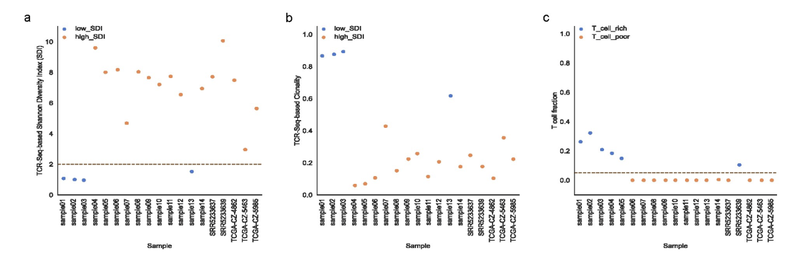
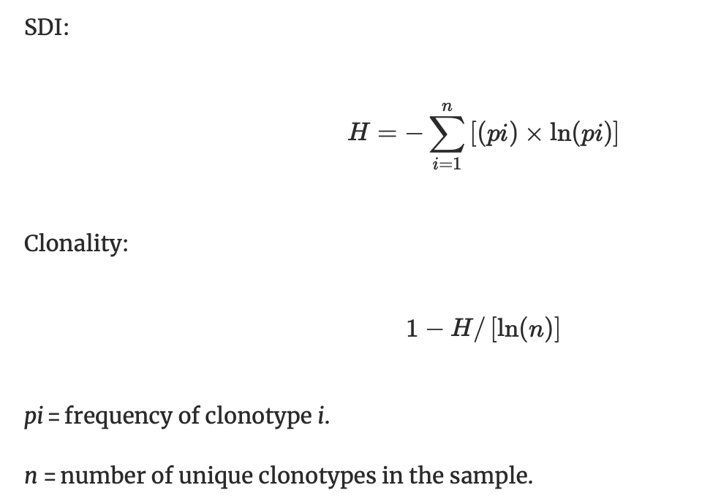
Distribution of Shannon diversity indices (SDIs), clonality scores, T cell fractions across samples
SDI of 2 is cutoff between
low and high SDI groups
Notes:
there is no standardized method to distinguish between low SDI and high SDI TCR repertoires. We chose the SDI value of 2 as the threshold which represents the distribution of clonotypes in the samples that we used in the study. We explored various SDI thresholds to classify low or high SDI samples and observed consistent estimates of clonality and diversity across various thresholds.
A low SDI sample is more predominated by one or a few TCR clonotypes. Such type of clonotype presentation is often observed in transgenic TCR cell therapies, where a TCR of interest has been inserted into a T cell via retroviral or lentiviral vectors, for the treatment of cancer or viral infections, or in situations where only a few TCR clonotypes are preferentially expanded in the setting of targeting cancer or viral antigens, thus reflecting their relative biological importance in a given sample. Conversely, a high SDI sample would be more reflective of circulating T cells which are not subject to the stressors of chronic antigen exposure, or tumor samples which have T-cell infiltrates directed at a wider variety of tumor neoantigens, which are diverse and unique to a given patient or individual tumor.
Also looked at clonality to take number of clonotypes into account (SDI doesn’t take this into account). Clonality normalizes clonotype counts based on SDI. Clonality = 1 – evenness (evenness measures diversity and richness), clonality of 1 means no evenness (monoclonal) and 0 means complete evenness (all clones equally represented, perfectly polyclonal)

Slide 7
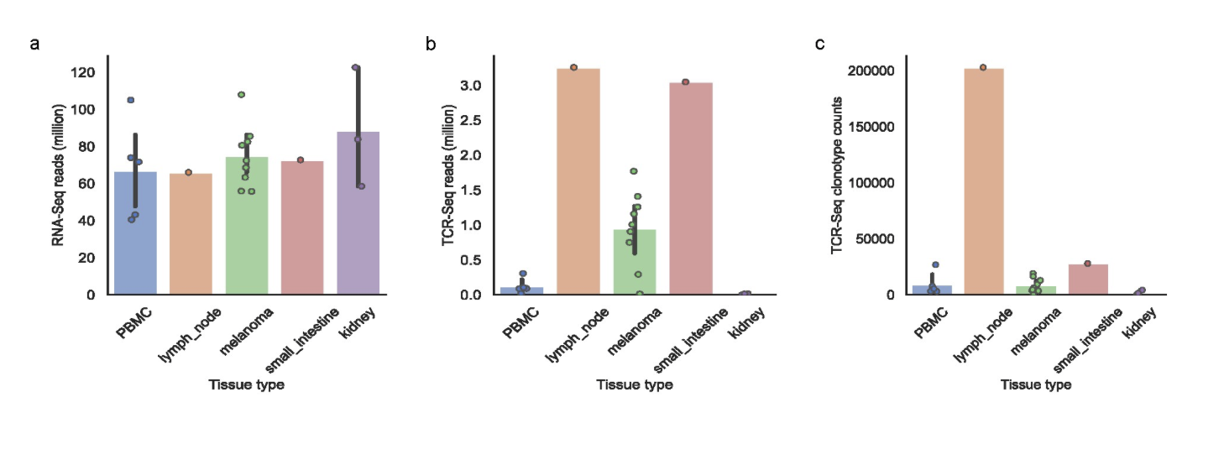
RNAseq reads are consistent across tissue types. Lymph node tissue is the most T cell rich
Notes:
Not sure why they called PBMCs T cell rich in earlier table…

Slide 8
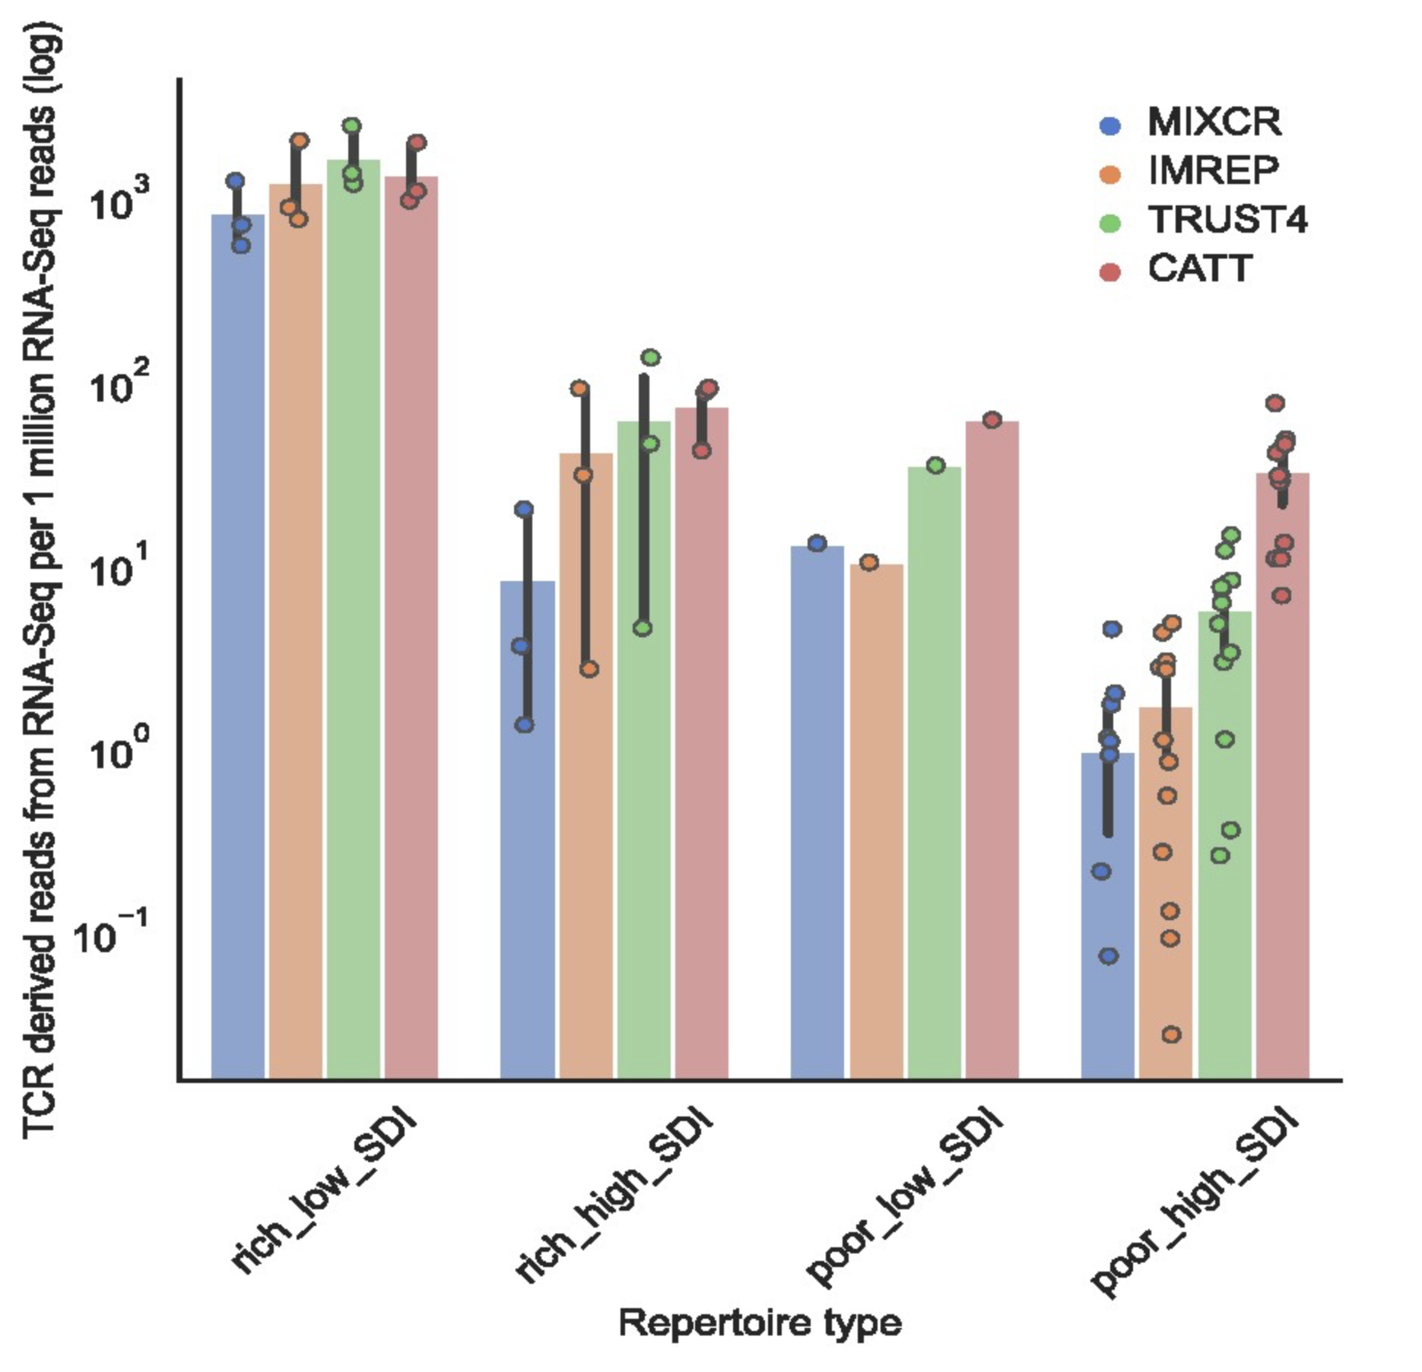
Fewer RNAseq derived TCR reads in T cell poor tissue vs. T cell rich tissue
Notes:
CATT and TRUST4 perform better than MiXCR in T cell poor high SDI samples

Slide 9
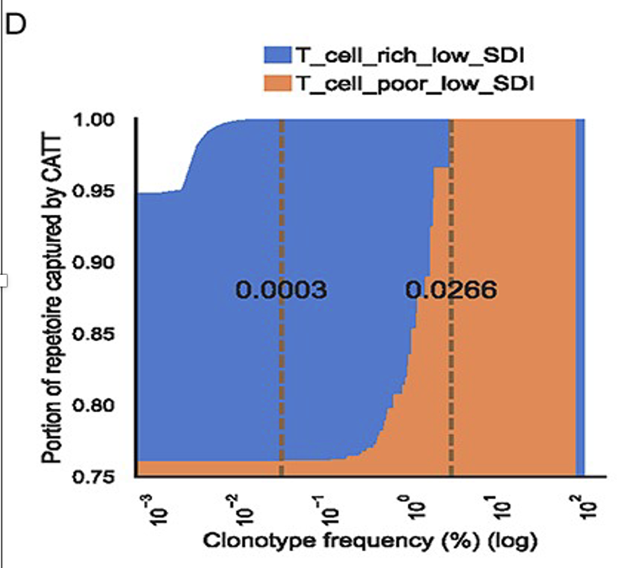
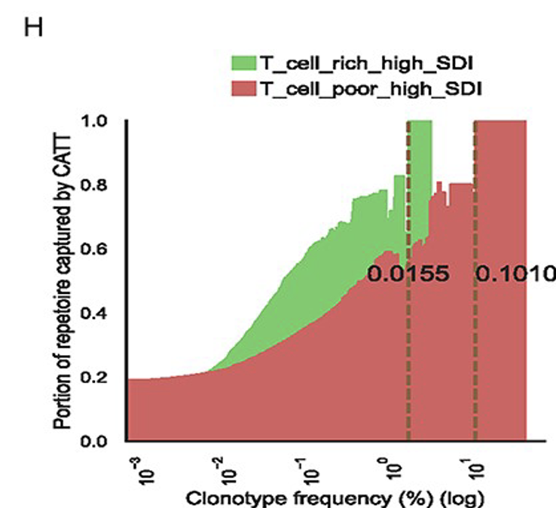
RNAseq methods capture most TCR clonotypes unless sample is T cell poor and high SDI (red)
Vertical lines: minimal clonotype frequency above which all TCRseq clonotypes are captured by RNAseq method
average fraction of RNAseq-
derived TCR clonotypes with clonotype frequency > Z
TCRseq confirmed clonotypes with frequency Z
Notes:
Representative method plots
Area plots show proportion of TCR clonotypes captured by method based on clonotype frequencies, i.e. better RNAseq method for non-poor/high SDI due to ability to capture all clonotypes with rarer frequencies
Capturing ability based on sum of TCRseq confirmed TCR beta clonotypes captured in RNAseq methods
Samples with no clonotype at given freq are excluded
RNAseq methods capture ~93% of clonotypes in T cell rich low SDI samples, ~76% in T cell poor low SDI samples (average capture %s)
on average TCRβ-derived reads from RNA-Seq reads in T-cell-poor tissues were much smaller than those in T-cell-rich tissues

Slide 10
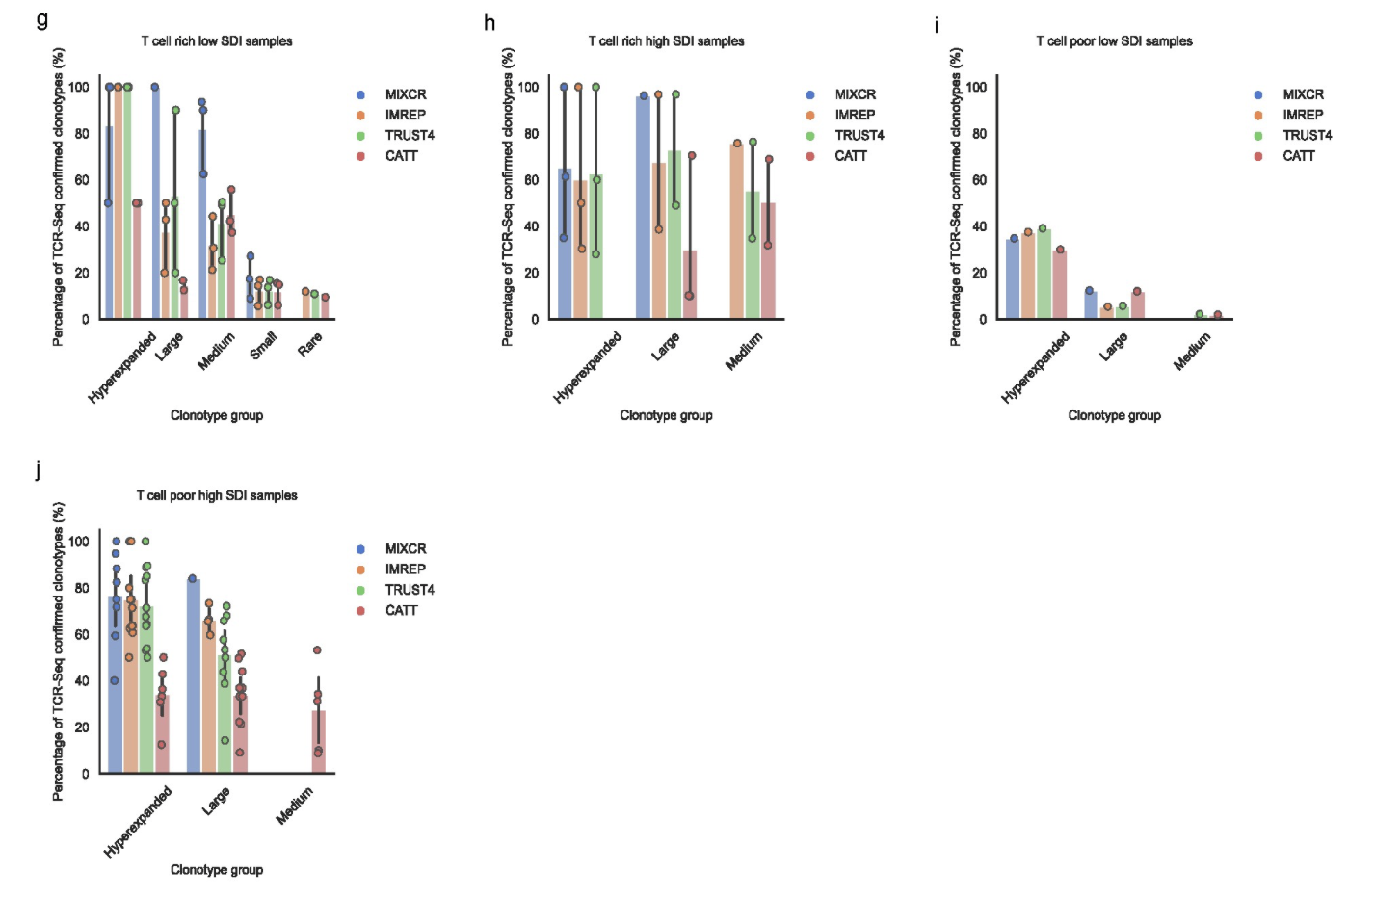
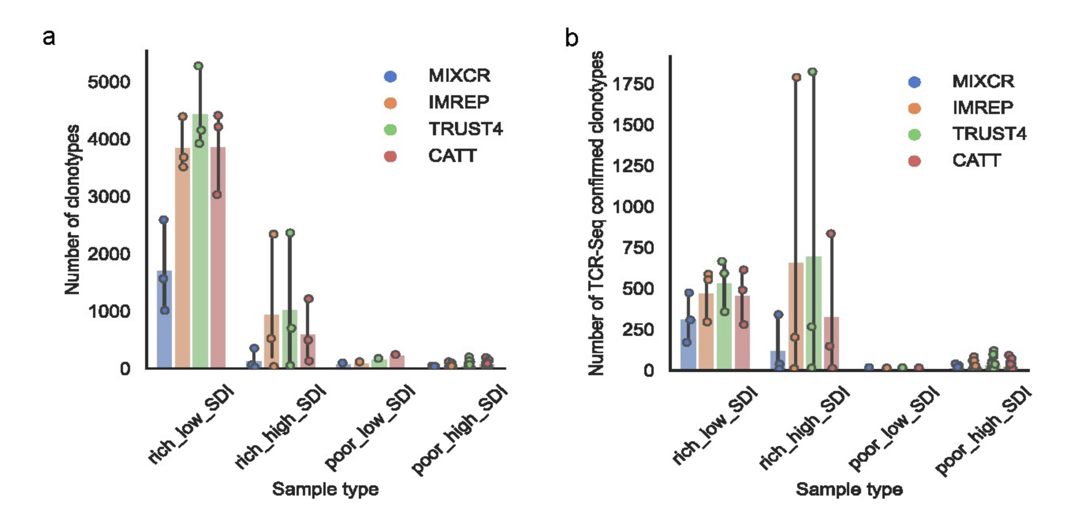
More highly expanded clonotypes are easier to detect, more clonotypes detected in T cell rich tissue
Notes:
ImRep, TRUST4 and CATT were able to detect more clonotypes and TCR-Seq confirmed clonotypes than MiXCR in T-cell-rich tissues. However, CATT had higher portions of the detected hyperexpanded and large clonotypes that were not confirmed by TCR-Seq than all other surveyed methods in T-cell-rich tissues and T-cell-poor high SDI samples.

Slide 11
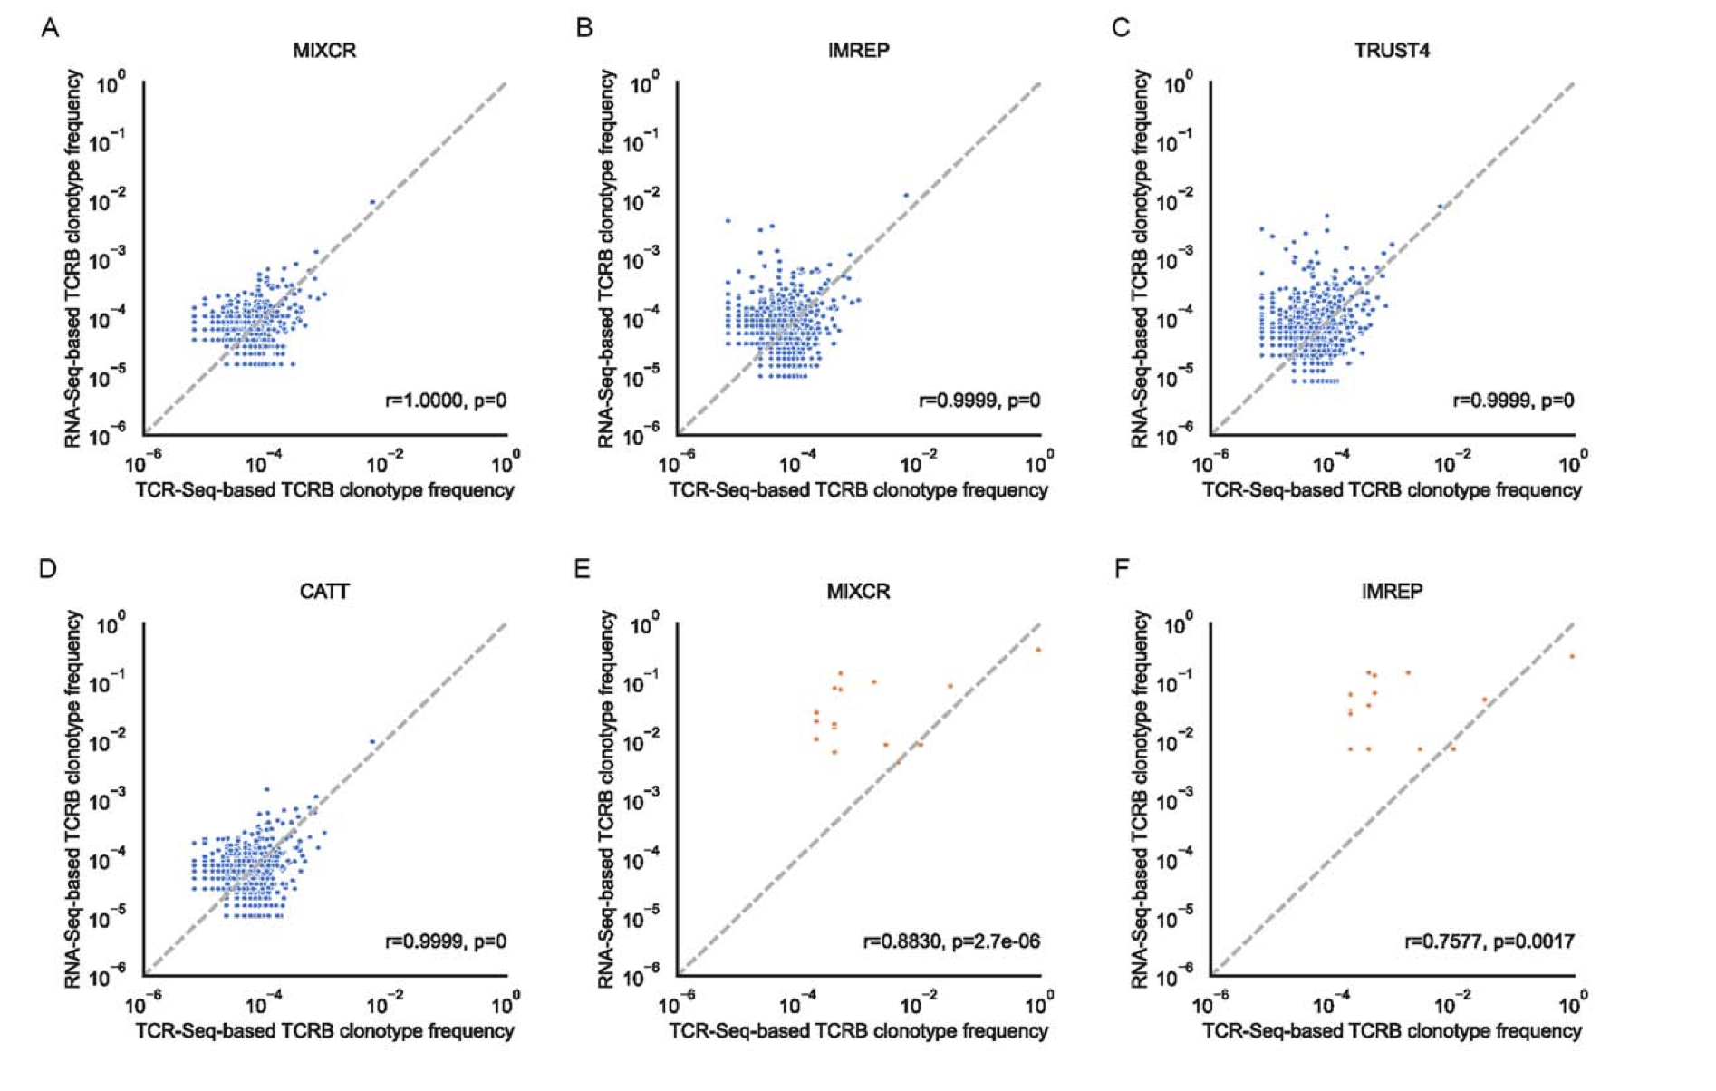
RNAseq methods estimate clonotype frequencies extremely well in T cell rich low SDI samples

Slide 12
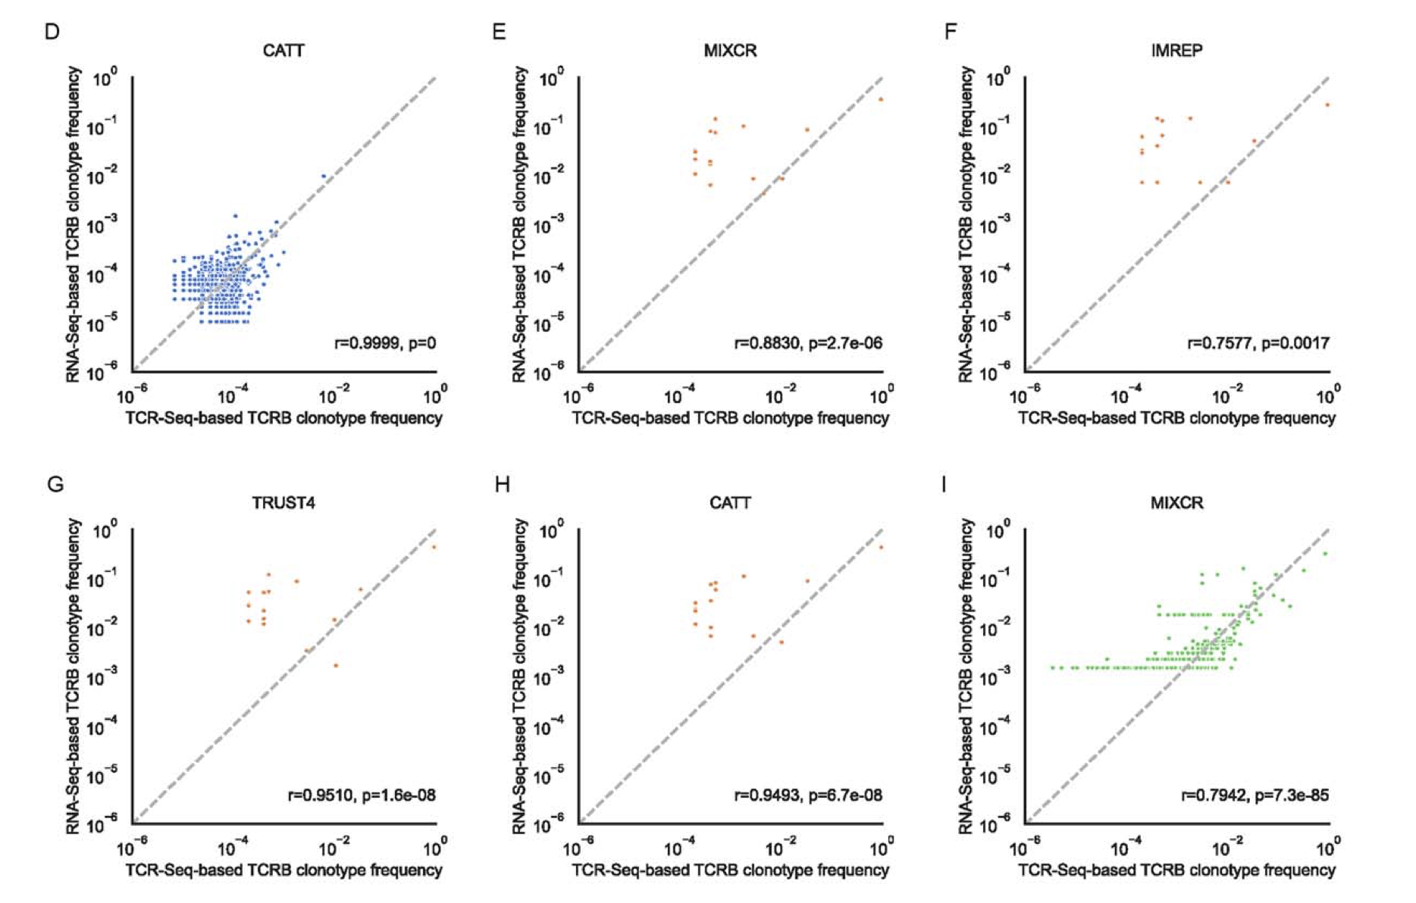
RNAseq methods estimate clonotype frequencies well in T cell poor low SDI samples
Notes:
RNA generally overestimates frequency

Slide 13
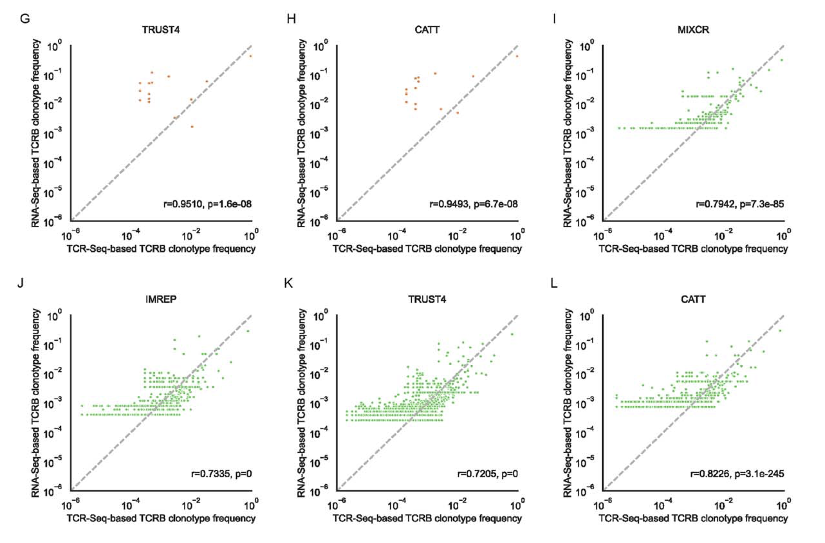
RNAseq methods estimate clonotype frequencies well in T cell high high SDI samples
Notes:
RNA generally overestimates frequency

Slide 14
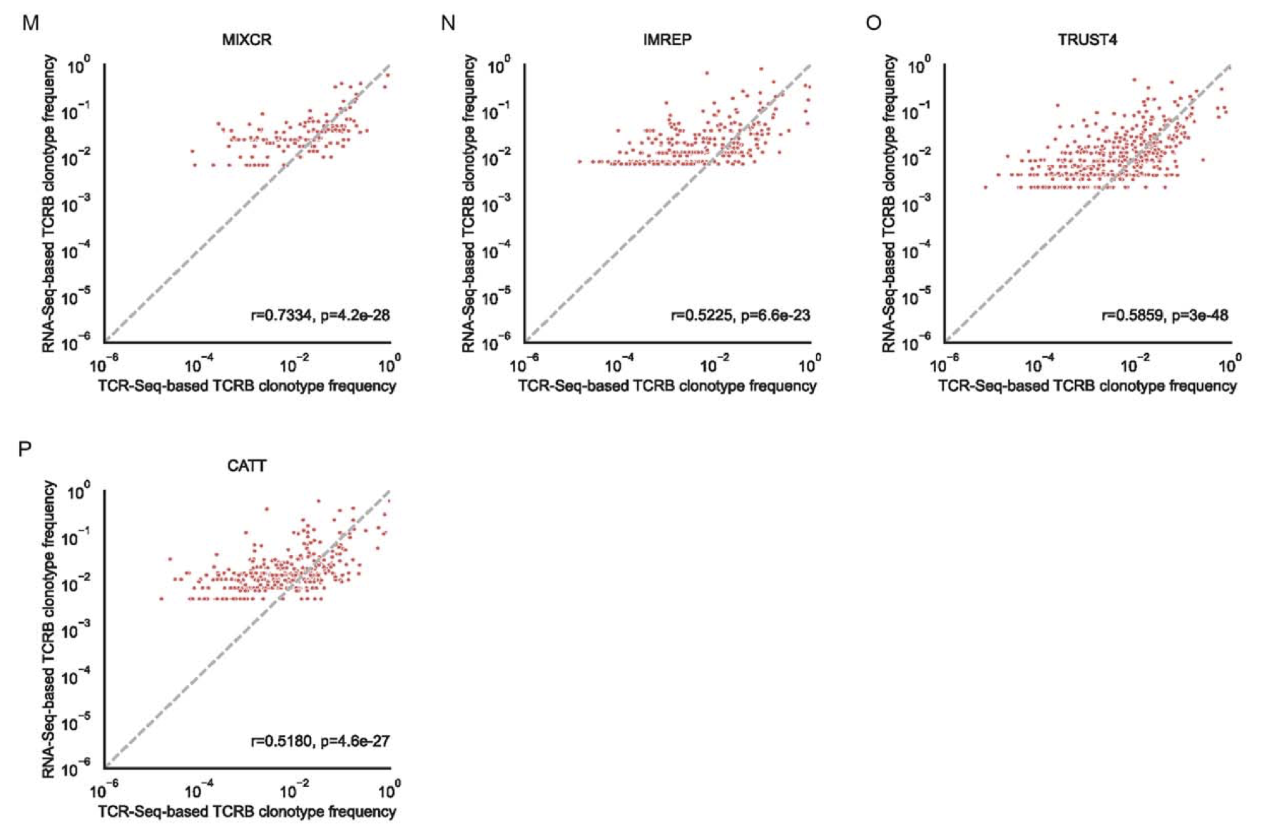
RNAseq methods estimate clonotype frequencies somewhat well in T cell poor high SDI samples
Notes:
RNA generally overestimates frequency

Slide 15
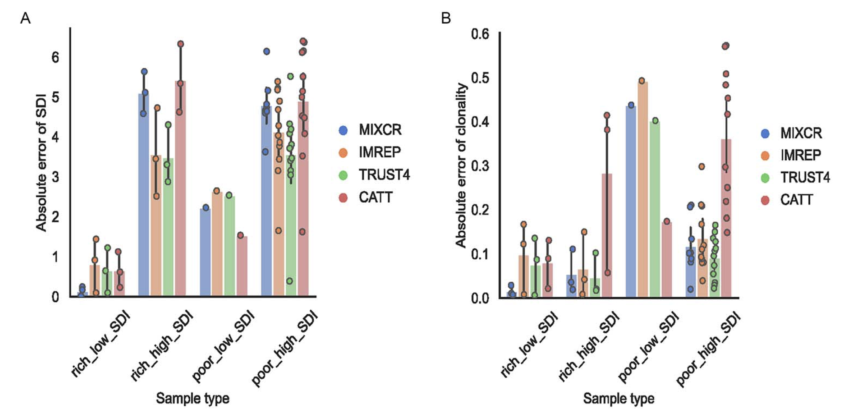
RNAseq methods better estimate SDI, clonality in low SDI, T cell rich SDI samples
error between RNAseq & TCRseq based SDI or clonality scores
Notes:
Lower error between RNAseq and TCRseq based diversity estimates in SDI low tissue
Also looked at clonality to take number of clonotypes into account (SDI doesn’t take this into account)
In addition, we investigated the ability of RNA-Seq-based methods to accurately estimate the diversity and clonality when singleton (clonotypes supported by a single read) TCRs were included. The presence of singletons in the sample decreases the accuracy of estimation for all methods. The average absolute error of SDI in T-cell-rich tissues across all methods was slightly higher than the samples excluding singleton TCRs, with values of 2.67 and 2.48, respectively. Similar to the samples excluding singleton TCRs, the surveyed methods provided reliable estimates of diversity in T-cell-rich low SDI samples
As expected, the number of clonotypes and derived reads detected by RNA-Seq-based methods are always lower than those from TCR-Seq. Clonotypes with low frequencies are not captured by the RNA-Seq-based methods; this may have caused a systematic underestimated error in estimating diversity.

Slide 16
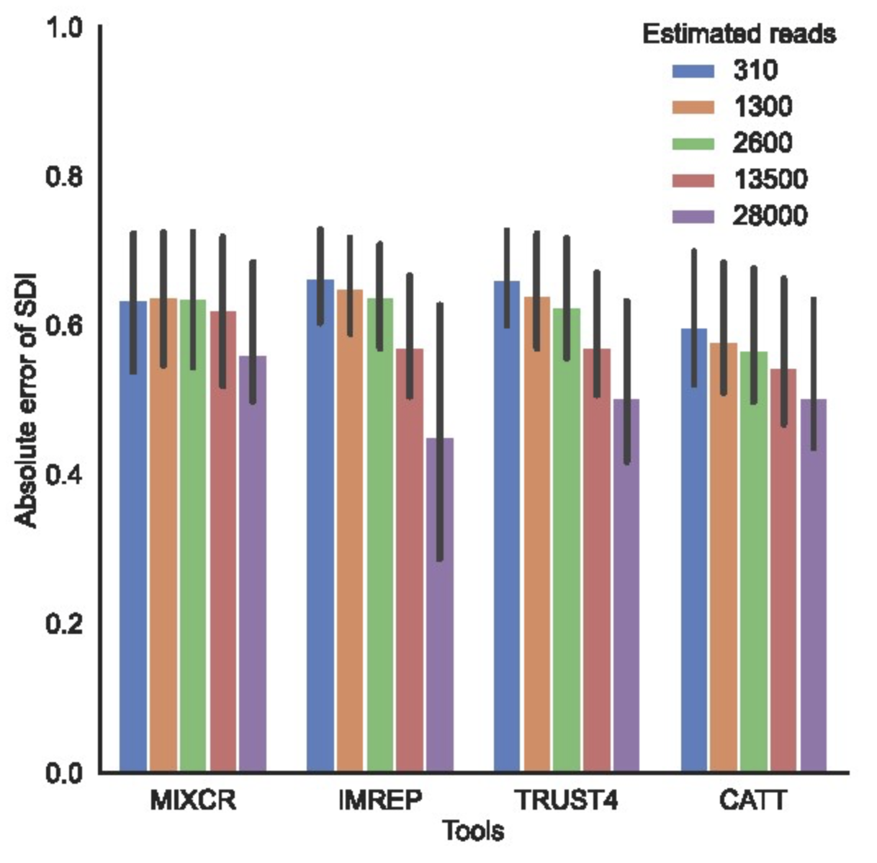
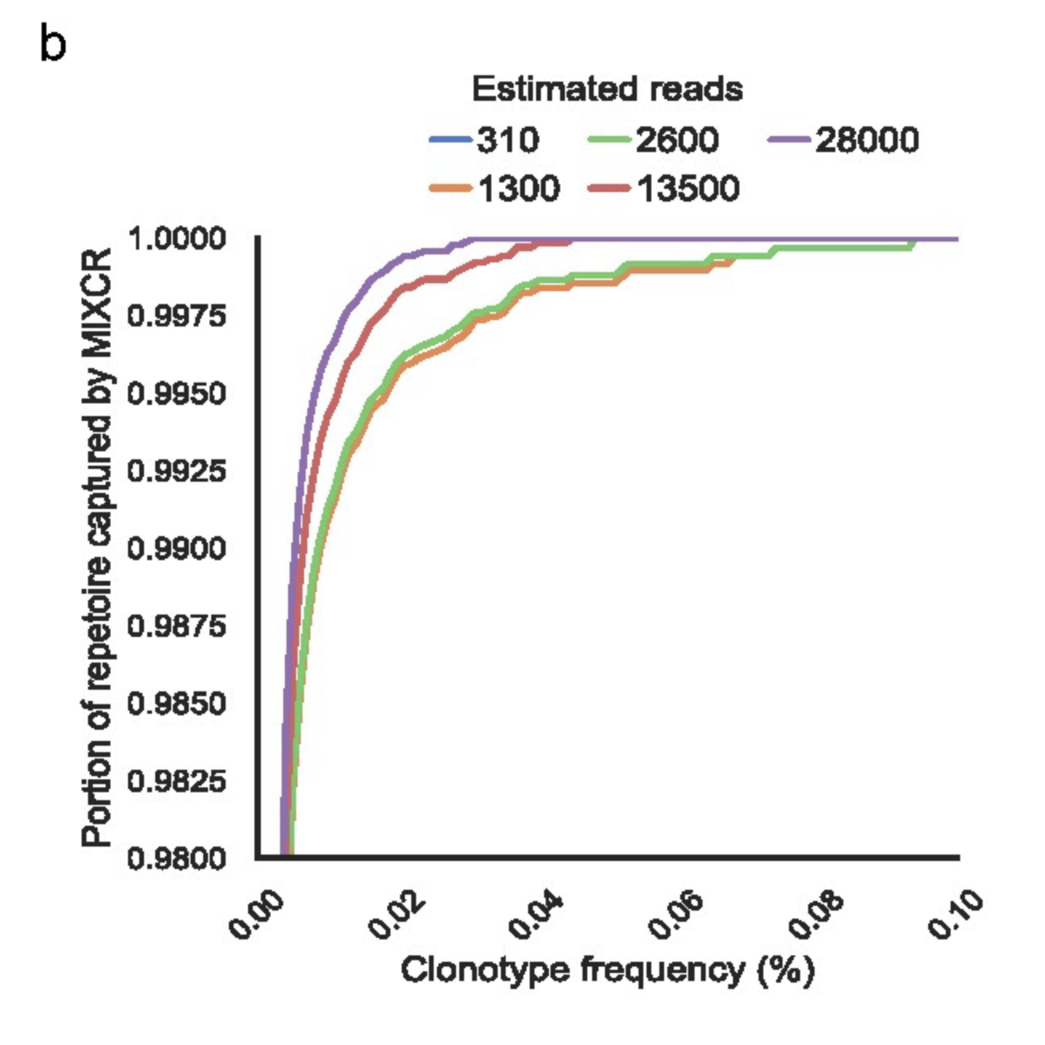
An increased number of TCR-derived reads results in more precise diversity estimate as rarer clonotypes are detected
Notes:
Other method plots looked similar to MiXCR one here (b)

Slide 17
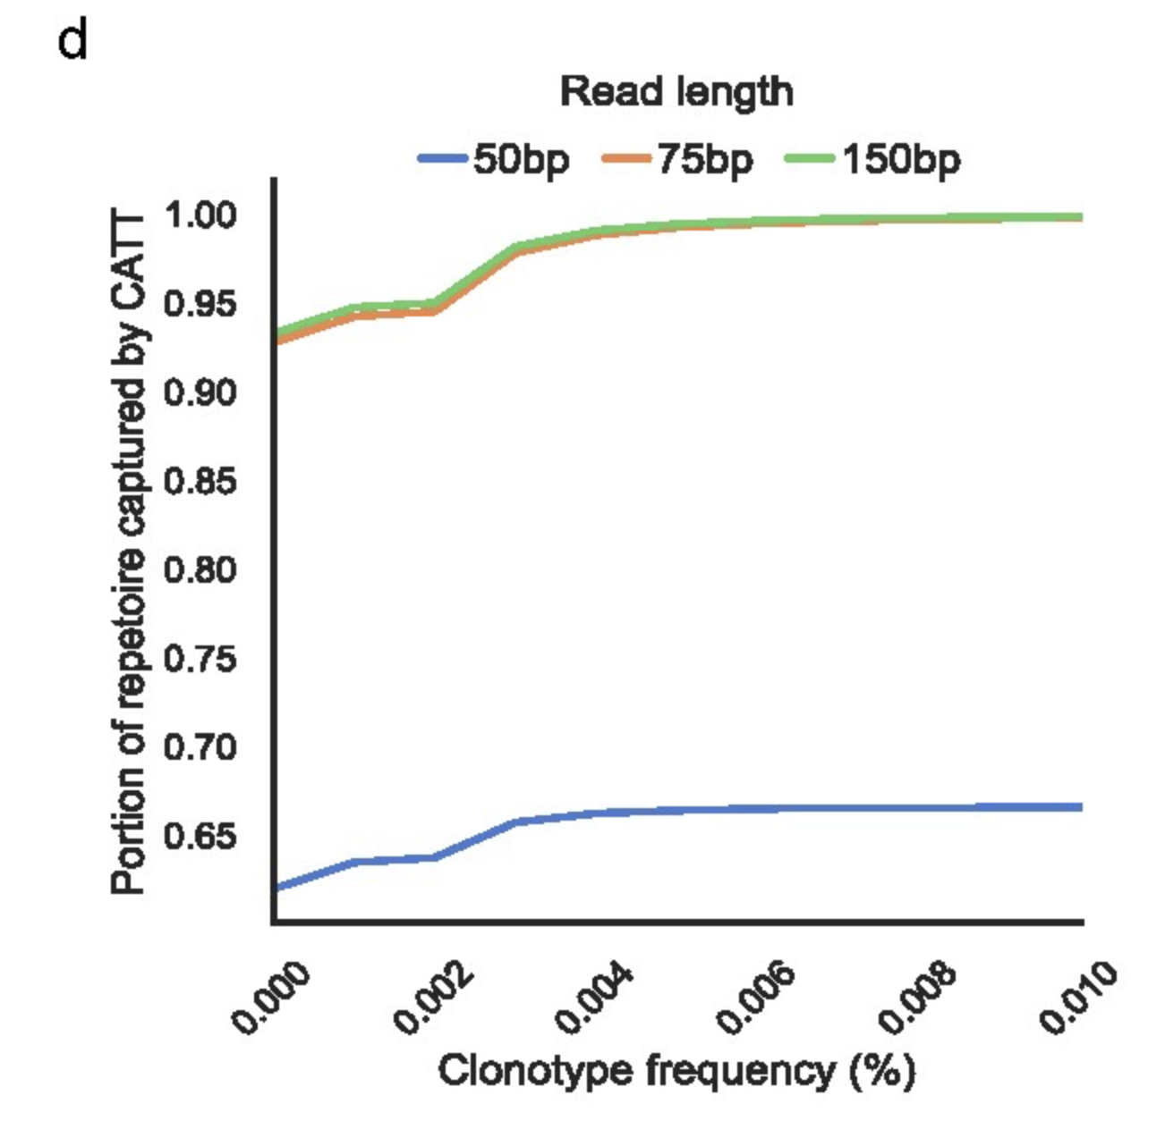
CATT method is most sensitive to short read lengths
Notes:
The length of RNA-Seq read was computationally reduced to 50 and 75 bp for PBMC samples (from 150 bp)

Slide 18
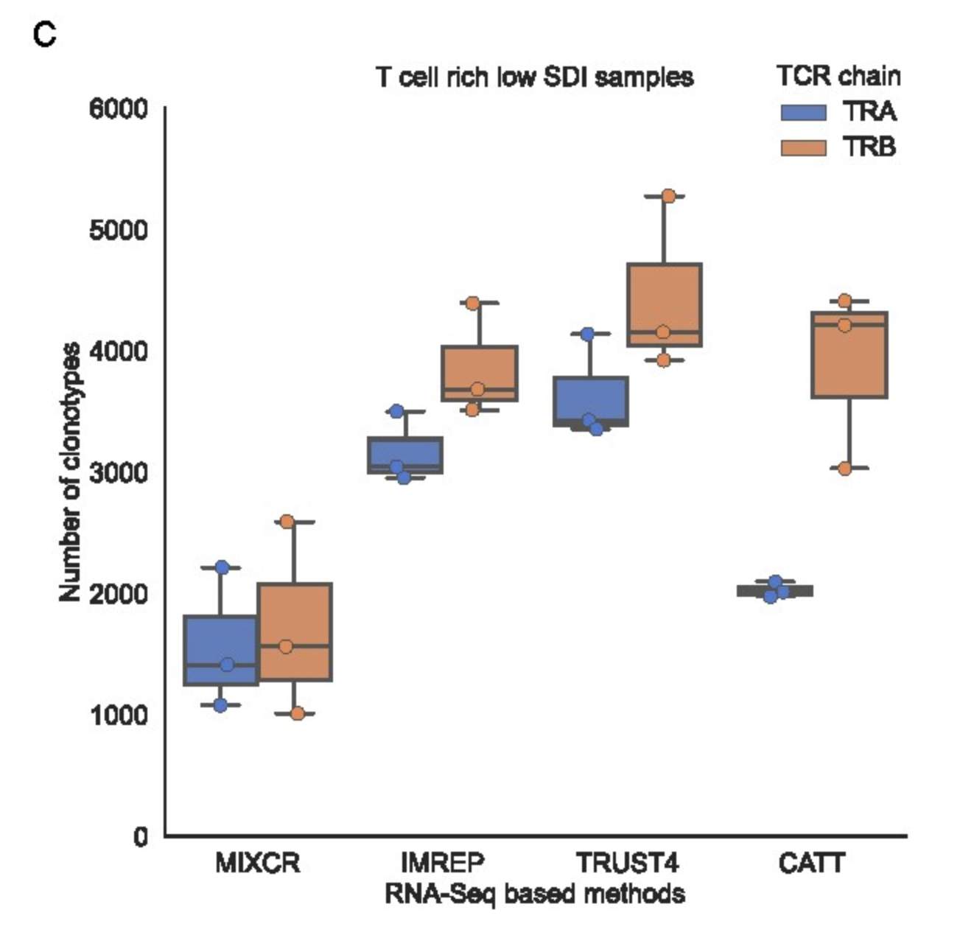
Most RNAseq methods, especially CATT, detect fewer TRA clonotypes

Slide 19
Conclusions
RNA-seq approach is suitable to profile TCR repertoire (capture clonotypes, estimate diversity/clonality, estimate clonotype frequencies) in T-cell-rich tissues with low diversity repertoires
Limited power of RNA-seq approach in T-cell-poor tissue, especially those with high T cell diversity
Similar results in healthy patients (data not shown)

Slide 20
Applications
Not being limited by needing both RNAseq and TCRseq performed, RNAseq can suffice if only interested in top clonotypes
Sometimes paired RNAseq TCRseq datasets have issue of cell having TCR clonotype information but no RNAseq information (& vice versa)
Saving on costs
Can profile α, β, γ and δ chains with single library preparation and sequencing, unlike with TCRseq, although results seem to vary by chain
Notes:
BRI has used RNAseq methods for TCR at sc not bulk level

Slide 21
Limitations
RNAseq method differences
CATT sensitive to short reads, worst at detecting TRA clonotypes
(cDNA) RNA method-derived clonotype count-based expansion metrics obscured by differences in RNA abundance among clonotypes (gDNA based clonotype counts reflect absolute cell counts)
Assembly may fail at bulk level for some (rare?) clonotypes
False positives from non-immune receptor genes with sequence patterns resembling TCR/CDR3 sequences
They did find TCR clonotypes by RNAseq methods not confirmed by TCRseq method here
Cannot differentiate between false positives of RNAseq based methods and false negatives of TCRseq method here
Notes:
TCR-derived reads corresponded to T-cell levels. However, RNA-Seq-based TCR profiling methods may also detect natural killer (NK) cells. Although NK cells were relatively rare compared with T cells, they could be added to the number of T cells that were deduced from the TCR reads. By utilizing GEDIT, we observed values of zeros in several samples, which may not indicate that there were no T cells in the samples; instead, these samples had low expressions which were below the detection limit

Slide 22
Extra slides

Slide 23
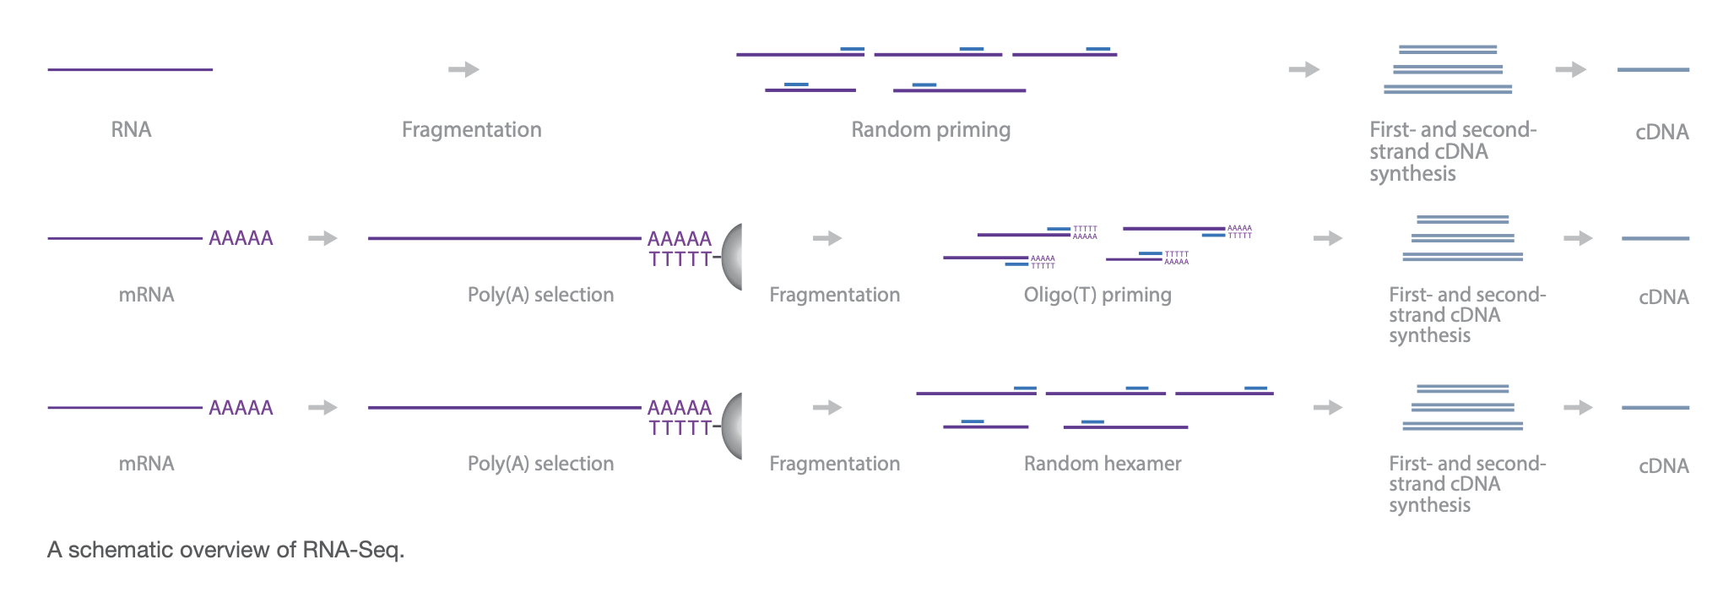
RNAseq methods

Slide 24
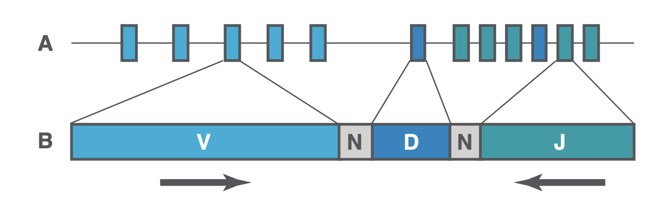
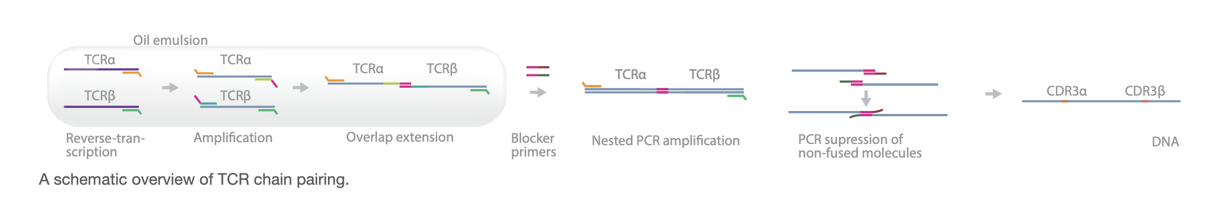
TCRseq methods
Multiplex PCR, or 5’ RACE
DNA or RNA based
Notes:
Multiplex: pool of primers binds all V and J genes, may be affected by biases
5’ RACE: rapid amplification of cDNA ends, single primer set targeting C gene
DNA as starting material: better quantification of clones but more expensive
RNA as starting material: more sensitive, measures TCR gene expression levels, able to incorporate UMIs to reduce PCR bias

Slide 25
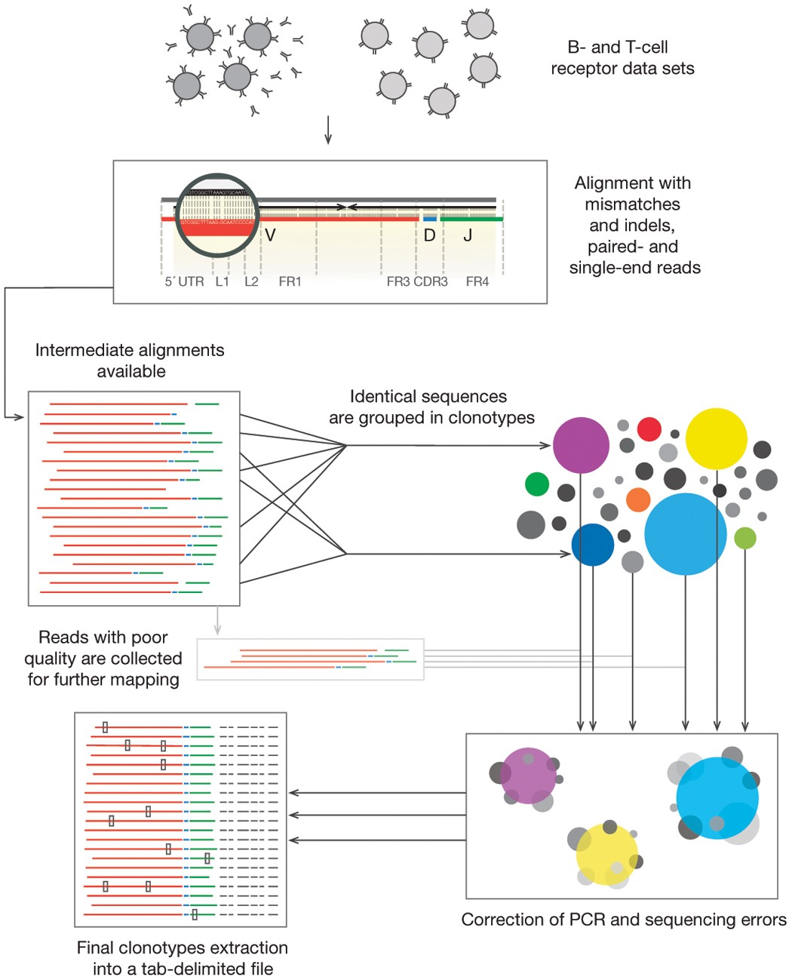
MiXCR main processing steps
align: align sequencing reads to reference V, D, J and C genes of T- or B- cell receptors
assemble: assemble clonotypes using alignments obtained on previous step (in order to extract specific gene regions e.g. CDR3)
export: export alignment (exportAlignments) or clones (exportClones) to human-readable text file

Slide 26
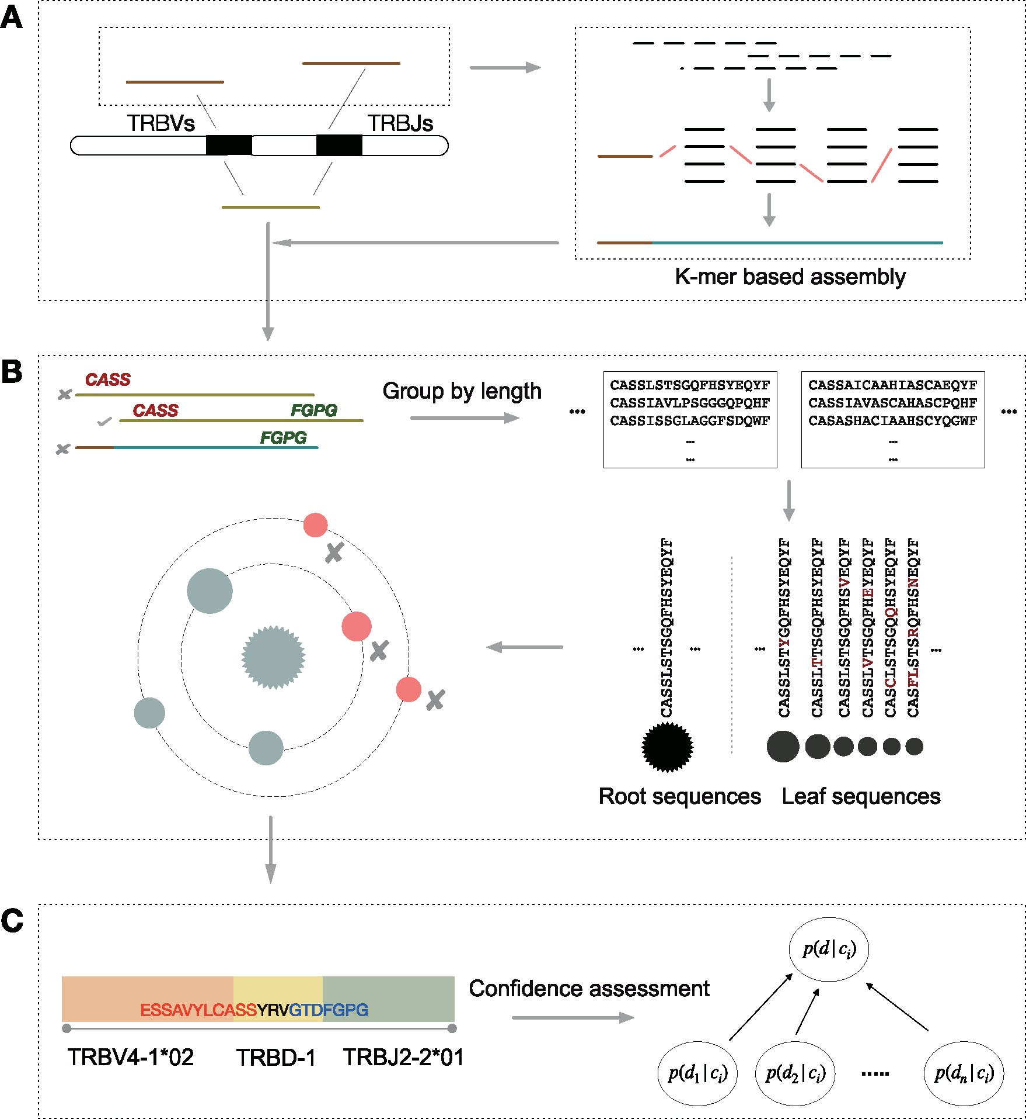
CATT (CharActerizing TCR repertoires) methods
Works for bulk and single cell TCRseq/RNAseq
Data-driven algorithm, self-adaptive to input data
Says it works even for very short reads
Figure details
A: candidate CDR3 detection. All reads aligned to V/J reference genes to screen candidate reads (brown) for microassembly. CDR3 seqs reconstructed by de Brujin graph-based greedy algorithm
B: error correction. Identify putative CDR3s using IMGT. Eliminate erroneous CDR3s (red)
C: annotation and confidence assessment

Slide 27
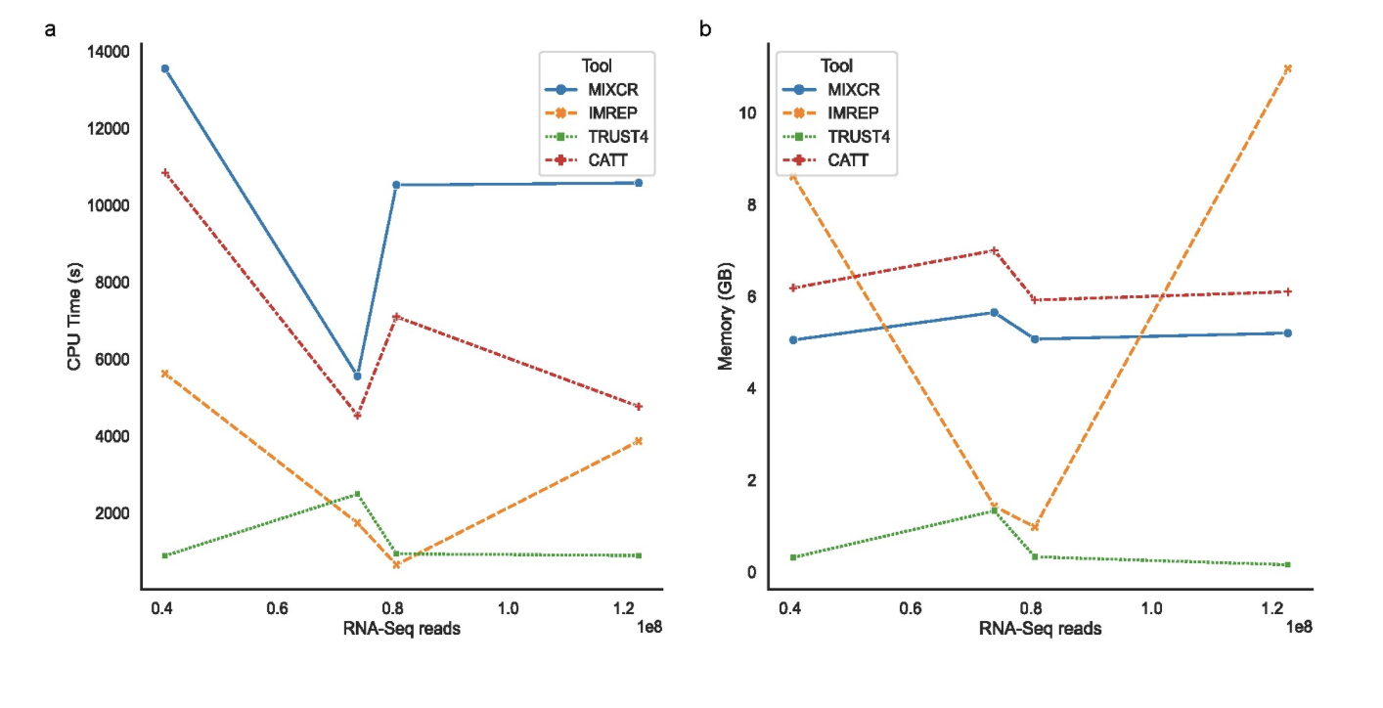
RNAseq methods differ in run time and memory requirements

Slide 28
IMREP methods
Infer CDR3 sequences (AAs between C on right of junction and F on left of junction) from reads that overlap V and J gene segments
CAST clustering technique to correct for PCR/sequencing errors
Defines clonotypes as clones with identical CDR3 AA sequences

Slide 29
TRUST4 methods
Uses unselected RNAseq data
De novo assembly on V, J, C genes including hypervariable CDR3
Reports consensus contigs
Realigns contigs to IMGT reference gene sequences to identify gene and CDR3 details
Supports single/paired-end bulk or single-cell sequencing data of any read length
Input: alignment of RNAseq reads in BAM format, along with genomic sequence with VJC gene coordinates, and reference database sequence with annotation information (i.e. IMGT), could also input raw RNAseq files (fasta/fastq)

Slide 30
Publication comments
TRUST and ImRep don’t consider nucleotide quality, MiXCR does (can be disabled)
False positives coming from genomic regions unrelated to immune receptor genes that contain sequence patterns resembling TCR/CDR3 sequences that don’t appear in TCRseq. Instances where TCR clonotypes are identified via RNAseq but not TCRseq could be false positives from RNAseq or false negatives from TCRseq (missed clonotypes). Hard to differentiate between 2 possibilities
Singletons (clones with 1 read) were removed as likely false positives, but perhaps it’s better to just go by Phred quality score to get at errors at nt level

